Slide 1

Computer Networks
Transport Layer

Slide 2
Topics of the day
Transport Layer
Services
Process-to-Process Communication
Addressing: Port Numbers
Multiplexing and Demultiplexing
Flow Control
Error Control
Congestion Control
Connectionless & Connection-Oriented Protocols

Slide 3
Transport Layer
Between Application and Network Layer
Provides services to the application layer
Ensures Process-to-process delivery
Also called Heart of TCP/IP protocol suite
End-to-End Logical vehicle

Slide 4
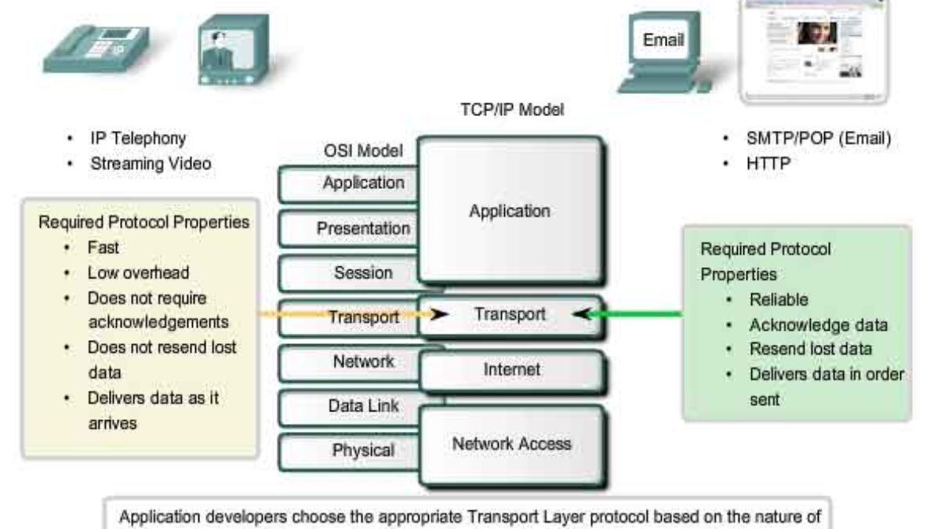

Slide 5

Services
Services provided by transport layer to the application layer are:
Process-to-Process Communication
Addressing: Port Numbers
Multiplexing and Demultiplexing
Flow Control
Error Control
Congestion Control

Slide 6
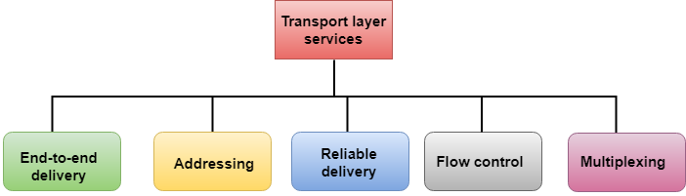
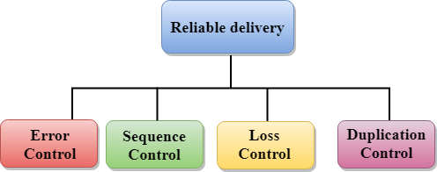
Services

Slide 7
Transport Services & Protocols
provide logical communication between app’ processes running on different hosts
implemented in end systems, but not in network routers
transport vs network layer services:
network layer: data transfer between end systems
transport layer: data transfer between processes
relies on, enhances, network layer services
Constrained by service model of Network-layer protocol
application
transport
network
data link
physical
network
data link
physical
network
data link
physical
network
data link
physical
logical end-end transport
network
data link
physical
network
data link
physical
application
transport
network
data link
physical
Let’s look at a simple analogy to see their subtle differences

Slide 8

Transport Layer V/S Network Layer
An Analogy: Cousins sending letters
East Coast
West Coast
Postal-service mail carrier
Uncle Sam
Uncle Bill
Uncle Sam & Uncle Bill - responsible for mail collection, distribution, and communicating with postal service
Postal service – carries the mails from house to house

Slide 9
Transport V/S Network Layer
hosts (also called end systems) = ?
processes = ?
application messages = ?
network layer protocol = ?
transport layer protocol = ?

Slide 10
Transport V/S Network Layer
Their services are constrained by the possible services that the postal service provides
hosts (also called end systems) = houses
processes = cousins
application messages = letters in envelope
transport layer protocol = Uncle Sam and Uncle Bill
network layer protocol = postal service (including mail persons)
It may so happen that their uncles could get sick, and so other people may take over – analogously, the computer network may provide multiple transport protocols

Slide 11
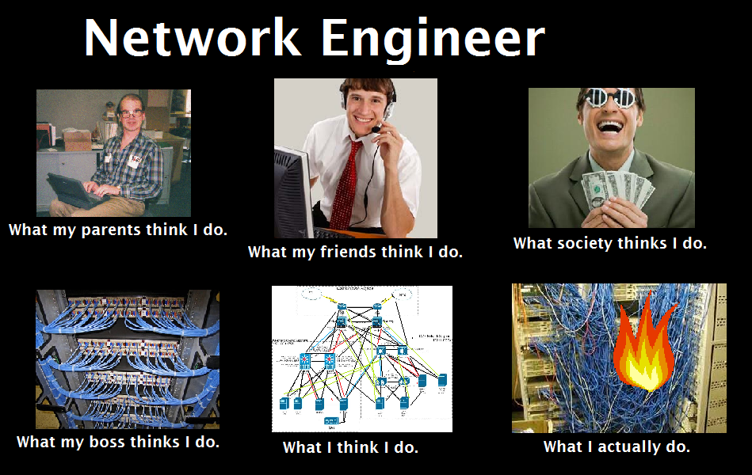

Slide 12
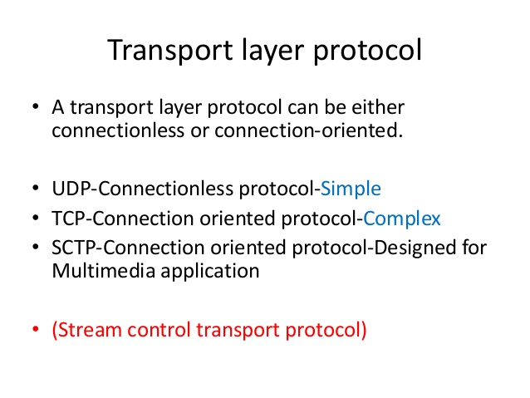

Slide 13
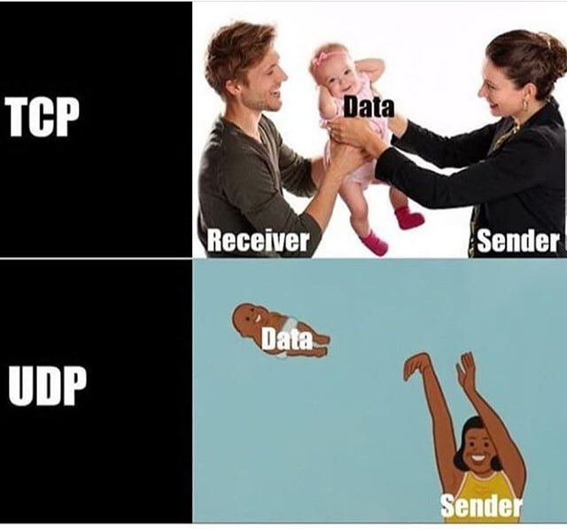

Slide 14
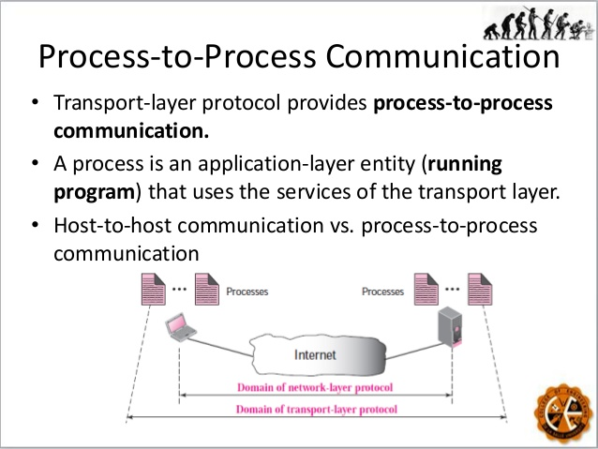

Slide 15
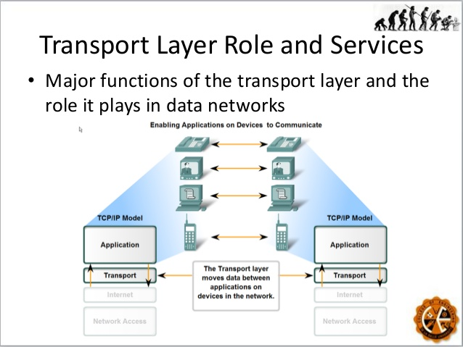

Slide 16
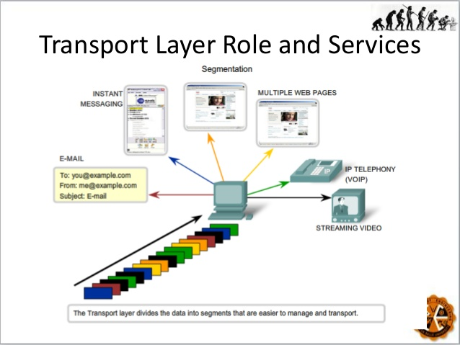

Slide 17
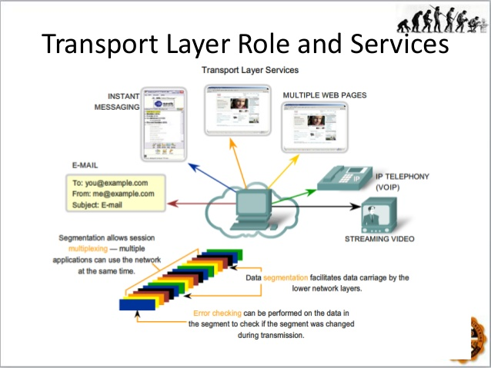

Slide 18
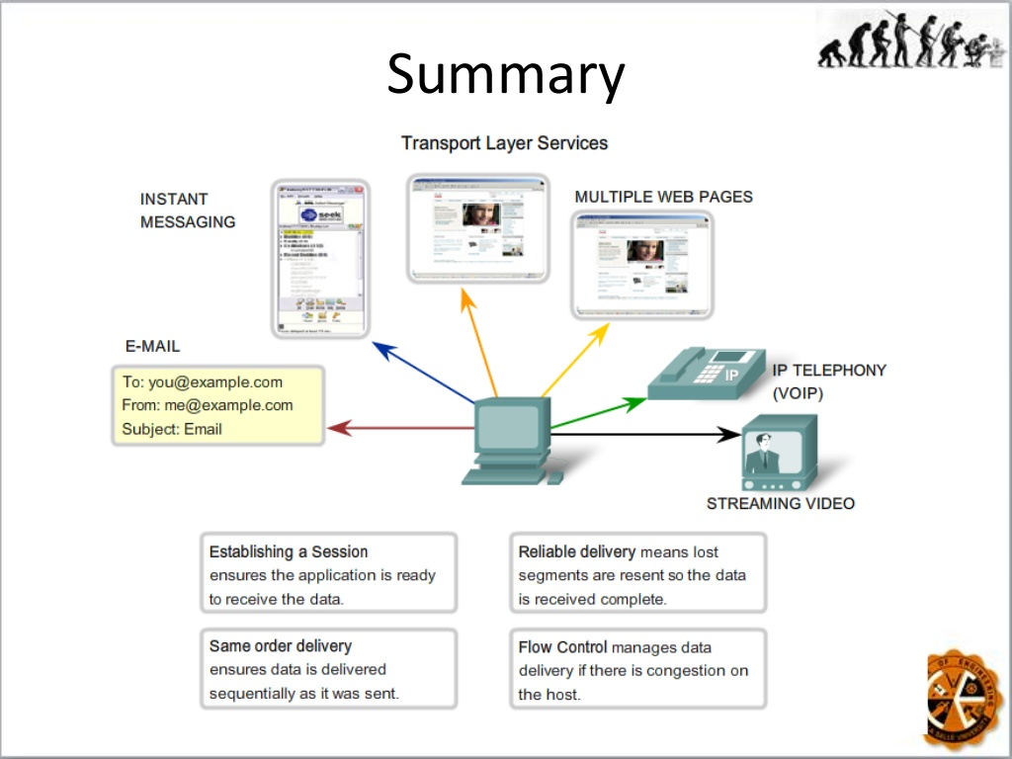

Slide 19
References
https://www.slideshare.net/jagadish2017/transport-layer-protocol
https://www.slideshare.net/MelvinCabatuan1/transport-layer-services

